Slide 1



COOKING RECIPE GENERATION MODEL FROM INGREDIENTS
Phan Trung Thuan – B2111957
CT216H – Thesis

Slide 2


CONTENT
DATASET
MODEL & METHOD
EXPERIMENT & DEMO
CONCLUSION

Slide 3
Dataset: mini-RECIPENLG (2k5 sample)
$$input=′ ′.join\left(ingredients\right)+′\backslash nInstruction: ′+′ ′.join(directions)$$
EXample:
2 eggs 4 tomatos olive oil 1 pkg pasta…
Instruction: Cut 4 tomatos into small piece. Fries the eggs with hot pan and live oil…

Slide 4
MODEL & METHOD
FINE TUNNING GPT2 SMALL VERSION (124M PARAMETERS)
HYPER PARAMETERS: SAME as gpt2 configuation
training: 250 epochs and 4 samples each batch
CROSS ENTROPY LOSS FUNCTION
ADAMW OPTIMIZER (LR = 5 * 10^(-4), DECAY = 0.1)

Slide 5
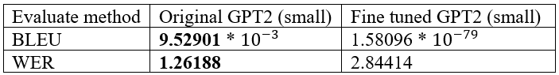
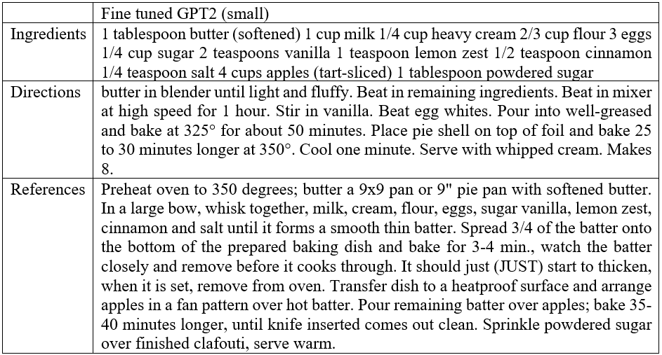
EXPERIMENT
TOP_K = 5
TEMPERATURE = 0.8

Slide 6
demostration

Slide 7
CONCLUSION

Slide 8

Thank you for listening

